Slide 1
Udacity Connect Session
March 10, 2018
Supervised Learning - Regression
github.com/zkhundkar/ConnectIntensive/04 ..

Slide 2
Welcome back!

Slide 3
Morning Schedule
10:00 - 10:30 | Housekeeping, Review
10:30 - 11:00 | Linear Regression and Gradient Descent
11:00 - 11:45 | Notebook session - Linear Regression
11:45 - noon | Review of Notebook session
© 2016 Udacity. All rights reserved.

Slide 4
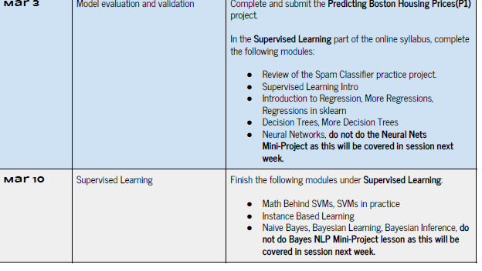

Slide 5
Review of Video Content
ML FOUNDATIONS REVIEW
Supervised Learning
Errors and Scores for Regression
Linear Regression
Multi-variate linear regression
Neural Nets
© 2016 Udacity. All rights reserved.

Slide 6
Supervised Learning
We have a dataset for which we know the “ground truth”
One variable of interest -- dependent variable (y)
All other variables -- features or independent variables
We want a reliable way to predict y based on the values of the dependent variables

Slide 7
Types of SL Problems
REGRESSION or CLASSIFICATION
Regression
Y (dependent) is a continuous variable
Classification
Y (dependent) is a discrete or categorical variable

Slide 8
Data Variability
Exploration, pre-processing
The goal of fitting a model to any data is to capture and “explain away” the variance in the data due to causes
“Correlation does not imply causality”
Should not try to account for random error
-- leads to “memorization” (overfitting)

Slide 9
Regression
ASSUMPTIONS ABOUT THE INDEPENDENT VARIABLES
Seek a model function
y = f(x₁, x₂, .. , x_{n}) minimize “error”
Independent Variables are IIDs
Independent
Drawn randomly from identical distributions
Most commonly assume gaussian distributions

Slide 10
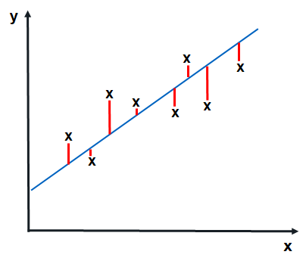
Error in Regression
REGRESSION
random - variance
y = w₁x + w₀
Total prediction error
Needs to be positive for both over-estimate and under-estimate
Shouldn’t depend on the number of samples

Slide 11

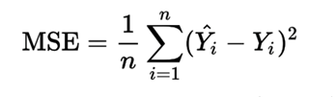
Error (Cost) Functions
REGRESSION y = w₁x + w₀, y = f(x)
Mean absolute error
Mean squared error

Slide 12
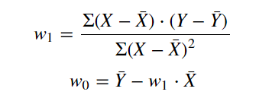
Exact Solution
FORMALLY CORRECT
0
Notes:
Understand the derivation of this two variable calculus

Slide 13
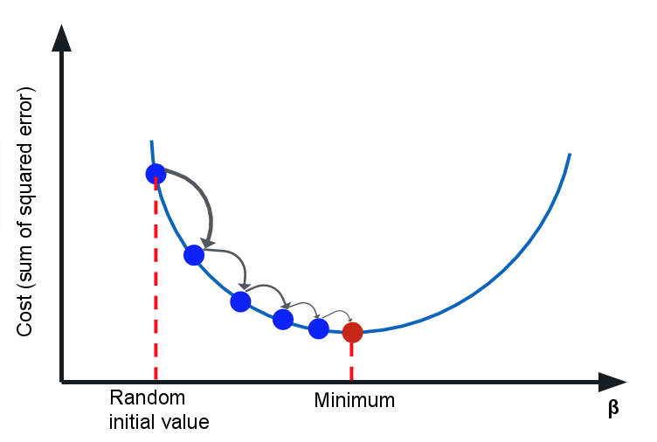
Linear Regression
MINIMIZING A COST FUNCTION
Cost Function C
C needs to be “smooth”
Depends on parameters
Minimize C - often MSE
Calculate direction of steepest descent
Take a step in this direction
Repeat until you get to the bottom

Slide 14
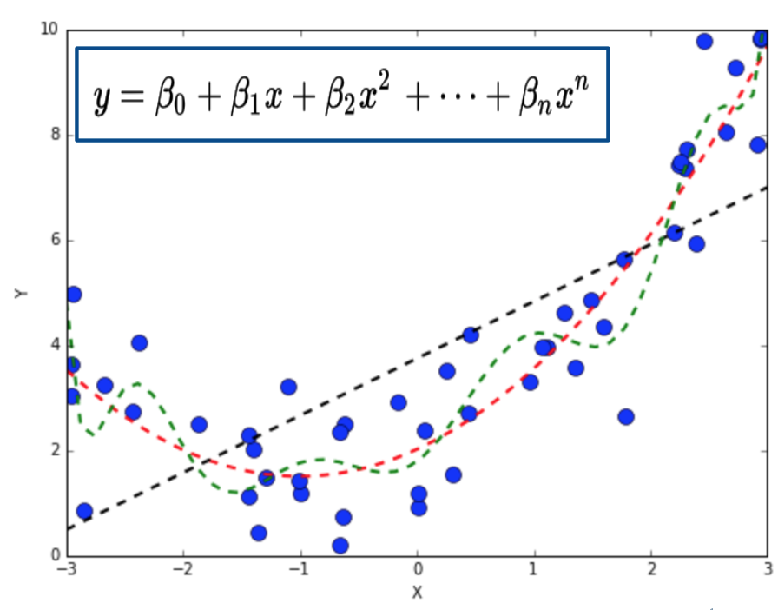
Complex Functions
POLYNOMIAL REGRESSION = LINEAR REGRESSION IN MANY DIMENSIONS
Y = w₀x⁰ + w₁x¹ + w₂x² + … + w_{n}x^{n}
Minimize C - often MSE
Calculate direction of steepest descent
Take a step in this direction
Repeat until you get to the bottom
Notes:
Weights are linearly distributed.

Slide 15
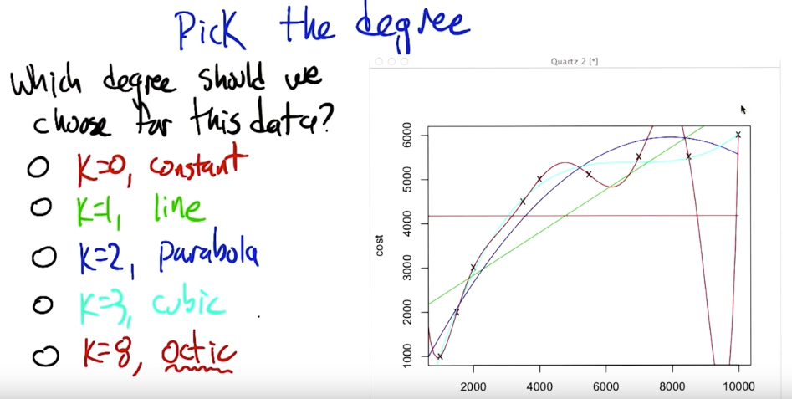
Polynomial Regression
© 2017 Udacity. All rights reserved.

Slide 16
Getting good models
Sensitive to outliers
Sensitive to large variations in numbers
Sensitive to learning rate
Most reliable best when dependent variables are IID gaussian (normal distribution)
Multicollinearity can prevent convergence
Error surfaces can be quite complicated

Slide 17
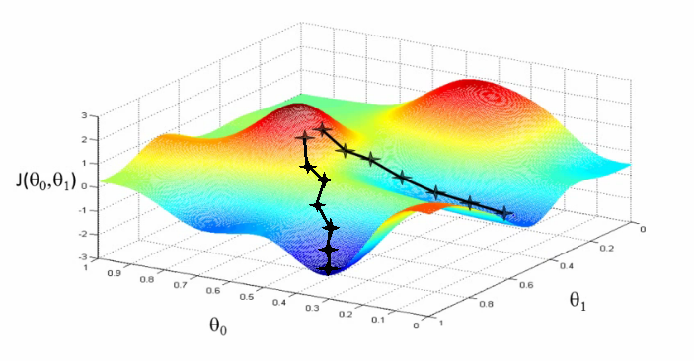
Error Surfaces

Slide 18
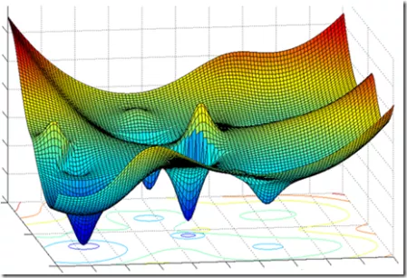
Error Surfaces

Slide 19
Feature scaling
REDUCE ALL INPUT TO NUMBERS OF SIMILAR SIZE
Addresses sensitivity to large variations in numbers
Z-score StandardScaler
X_std = (X - X.mean) / (X.std)
MinmaxScaler
X_std = (X - X.min) / (X.max - X.min)

Slide 20
github.com/zkhundkar/ConnectIntensive/
04a Linear Regression

Slide 21
Lunch Break

Slide 22
Afternoon Session
1:00 - 1:45 | Introduction to Neural Nets
1:45 - 2:30 | Notebook Session - continue
2:30 - 2:50 | Review Notebook
2:50 - 3:15 | Recap, Lookahead and Feedback
3:15 - 5:00 | Work on Project 1 Work on Project 2 (if P1 complete)
© 2016 Udacity. All rights reserved.

Slide 23
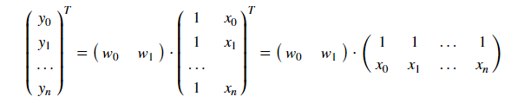
Matrix Representation
LINEAR REGRESSION
Y = WX^{T}

Slide 24
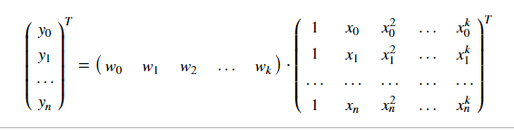
Matrix Representation
MULTI-VARIATE LINEAR REGRESSION
Y^{T} = WX^{T}
Notes:
(m x k) * (k x n) = (m x n)

Slide 25
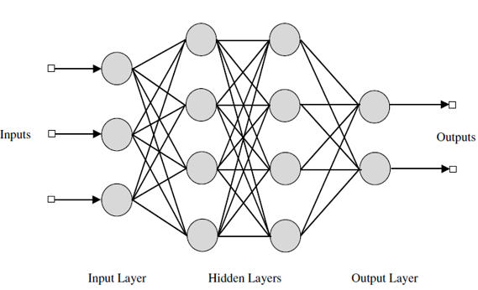
Neural Networks - Classification
Notes:
3 nodes to 4 nodes = 12
4 nodes to 4 nodes = 16
4 nodes to 2 nodes = 8
Total 32 parameters

Slide 26
NN - Matrix representation
Input layer - do nothing (pre-processing required)
Each hidden layer:
- Multiply “inputs” by weight matrix (parameters)
- Apply activation function to get output
- Output of one hidden layer -> input of next layer
Output layer - do nothing

Slide 27
NN - Activation functions
Key characteristics
- vary smoothly between 0 and 1 (or -1 and 1)
- non-linear ** very important**
- differentiable

Slide 28
NN - Activation functions
Common ones
Rectified linear units (reLU)
Sigmoid or logistic function
Hyperbolic tan (tanh)
softmax

Slide 29
NN - Minimizing error
Logloss - commonly used error function
Gradient descent -- using backpropagation (efficient)
Y_{p} = h_{n}(...h₂(h₁(XW₁^{T})W₂^{T})..W_{n}^{T})
Shape of each W_{i}
#outputs x #inputs - no bias
#outputs x #inputs + 1 - bias

Slide 30
Prep for next week
Start Donors for Charity Project
Supervised Learning Unit
SVM, Bayesian Inference/Learning, Ensemble Methods

Slide 31
Mar 10 | Supervised Learning | Unit 2 - Lessons 9 - 14 Finish the following modules under Supervised Learning : ● Math Behind SVMs, SVMs in practice ● Instance Based Learning ● Naive Bayes, Bayesian Learning, Bayesian Inference ● Ensemble B&B Do not do Bayes NLP Mini-Project lesson as this will be covered in session next week. Review the Finding Donors for CharityML project.

Slide 32

We really need your Feedback!
© 2016 Udacity. All rights reserved.

